Slide 1
HEALTH BUDDY
PIP2001 Capstone Project
Review-0
Batch Number:CSE133
Under the Supervision of,
Dr./Mr./Ms./Prof. Dr.Shanmugarathinam
Professor / Associate Professor / Assistant Professor
School of Computer Science and Engineering
Presidency University
Roll Number | Student Name
20211CSE0531 | Tilakraj Ratnanj Revankar
20211CSE0532 | Siddhant Chavan
20211CSE0537 | Anisha Kumari
20211CSE0547 | Poorvika P
Name of the Program: CSE
Name of the HoD: Dr. Blessed Prince P/Dr. Robin Rohit/Dr.Asif Mohammed H.B
Name of the Program Project Coordinator: Mr. Amarnath J.L & Dr. Jayanthi. K.
Name of the School Project Coordinators: Dr. Sampath A K / Dr. Abdul Khadar A / Mr. Md Ziaur Rahman

Slide 2
Content
Problem Statement
Github Link
Analysis of Problem Statement
Timeline of the Project
References

Slide 3
Problem Statement Number:
Organization: Cognizant
Category (Hardware / Software / Both) :Software
Problem Description: Basically our app allows you to enter the food you ate and with the help of a trained model it'll be able to predict the different types of vitamins and proteins and also calculate the calories consumed. After analyzing the data entered by the user for a couple of days, the app will tell you what vitamin you might be deficient of and the possible diseases you might get if you don't include that in your diet. It also keeps a track of the number of glasses of water you've had while also reminding you to hydrate yourself regularly. It also keeps a track of your physical activities and calories burned.
Difficulty Level: Moderate.

Slide 4
Github Link
Github Link :
https://github.com/CSE133/Capstone-project---Health-buddy

Slide 5
Analysis of Problem Statement
Technology Stack Components:
1. Front-End: Frameworks/Libraries: React Native; React
Design: Adobe XD.
2. Back-End: Languages/Frameworks: Node.js, Django (Python), Spring Boot (Java)
APIs: REST.
3. Databases: Relational: MySQL
NoSQL: MongoDB.
4. Machine Learning: Frameworks: TensorFlow, PyTorch
Libraries: Pandas, Scikit-learn.
5. Cloud & Infrastructure: Providers: AWS, Google Cloud, Microsoft Azure

Slide 6
Analysis of Problem Statement
Technology Stack Components:
6. Analytics & Monitoring: Analytics: Google Analytics
7. Communication & Notifications: Push Notifications: Firebase Cloud Messaging
9. Development Tools: IDEs/Editors: Visual Studio Code, IntelliJ IDEA
Version Control: Git, GitHub.

Slide 7
Analysis of Problem Statement (contd...)
Software Requirements:
Development Tools: IDEs/Editors: Visual Studio Code, Android Studio
Version Control: Git, GitHub/GitLab/Bitbucket
CI/CD: Jenkins, GitHub Actions, GitLab CI/CD.
Front-End Development: Frameworks/Libraries: React Native, Flutter, Kotlin (Android)
Back-End Development: Languages/Frameworks: Node.js, Spring Boot (Java), ASP.NET Core (C#)
Databases: Relational: MySQL
NoSQL: MongoDB.
Management Tools: MySQL Workbench, MongoDB Compass
Machine Learning & Data Analysis: Frameworks: TensorFlow, PyTorch
Libraries: Pandas, NumPy, Scikit-learn.

Slide 8
Analysis of Problem Statement (contd...)
Software Requirements:
Cloud & Infrastructure: Providers: AWS, Google Cloud
Storage: Amazon S3, Google Cloud Storage.
Communication & Notification: Push Notifications: Firebase Cloud Messaging, Project Management & Collaboration: Project Management: Jira, Trello
Communication: Microsoft Teams.
APIs & Integration: Nutrition Databases: USDA Food Data Central, Nutritionix API
Wearable Integration: Google Fit API, Apple HealthKit AP .

Slide 9
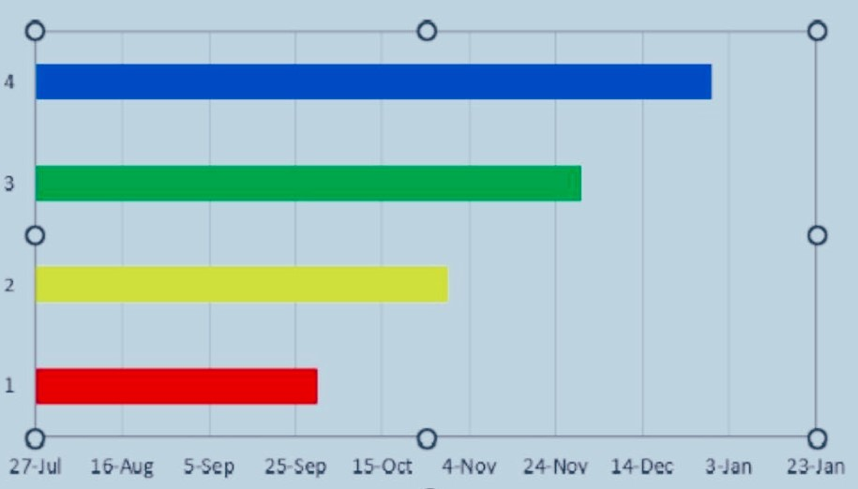
Timeline of the Project (Gantt Chart)

Slide 10
References (IEEE Paper format)
Add APA Citation for all references. Github
Use the below link for various APA styles :
Research Paper: https://mhealth.jmir.org/2016/3/e85/
https://www.researchgate.net/publication/364083577_Nutrition_information_estimation_from_food_photos_using_machine_learning_based_on_multiple_datasets
https://www.ncbi.nlm.nih.gov/pmc/articles/PMC5499922/
Dataset:
https://www.kaggle.com/datasets/utsavdey1410/food-nutrition-dataset

Slide 11


